Slide 1
DIA Clinical Safety and Pharmacovigilance Community
All Hands Meeting
22 December 2016

Slide 2
Today’s Agenda
Agenda:
Presentation by a guest speaker on the basic principles of Small Molecule Drugs, Biosimilars, and Biologics
Introduce new CSP Core Team
January 2017 Safety/PV Conference in DC Update
Open Forum

Slide 3
Postponed Topic DIA CSP AHM 22-Dec-2016
Small Molecule Drugs, Biosimilars, and Biologics presented by Sasha Gallagher, PharmD candidate
Back-to-basics presentation for those in the community who aren't MDs, PhDs, PharmDs, etc., who may want a simple tutorial on the subject
Postponed to First week Jan 2017

Slide 4
DIA CSP AHM 22-Dec-2016
CSP Community Leaders – Volunteer Opportunity

Slide 5
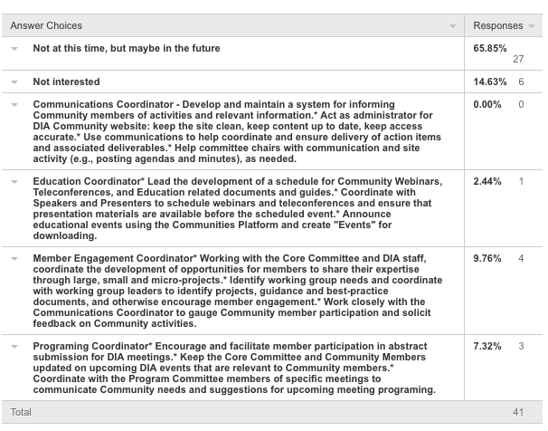
DIA CSP AHM 22-Dec-2016

Slide 6
DIA CSP AHM 22-Dec-2016
The new DIS Clinical Safety & Pharmacovigilance Community Core Leadership Team
Communications Coordinator (1 year term) - Jill Notte (US)
Education Coordinator (1 year term) - Cristina Parau (GB)
Member Engagement Coordinator (1 year term) - Teiki Iwaoka (JP)
Programing Coordinator (1 year term) - Pierre-Yves De Zeeuw (FR)

Slide 7
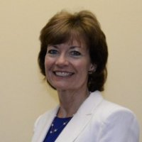
DIA CSP AHM 22-Dec-2016
Communications Coordinator – Jill Notte
Jill Notte is the Director of Global Marketing for APCER Life Sciences, a provider of safety, medical, and regulatory services. She is responsible for marketing strategy and communicates APCER’s value propositions through multiple channels. Jill has been in the field of pharmacovigilance and active in DIA meetings around the world since 2001, when she was Director of Marketing for Sentrx (now C3i). Prior to that, Jill was a Client Manager for IBM, selling hardware, software, services, and consulting to a variety of global pharmaceutical and consumer package goods accounts. Jill has a Bachelor of Science degree in Chemical Engineering from Lafayette College.

Slide 8
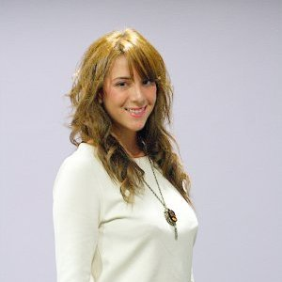
DIA CSP AHM 22-Dec-2016
Education Coordinator – Cristina Parau (GB)
Cristina is a pharmacist by education. After graduating from her MPharm she realised she was drawn towards the industry side of the profession. In pursuit of a career in industry, she undertook an internship with WHO in Patient Safety and following that, carried on with her education by attending an MSc in “Drug Discovery & Pharma Management” at UCL.
She joined PDS as an intern while she was working on her thesis and after graduation became a full-time member of our team.
Hobby wise she is a member of the Rotary club where she volunteers for numerous charitable activities, she enjoys horse riding, tennis, swimming and travelling.

Slide 9
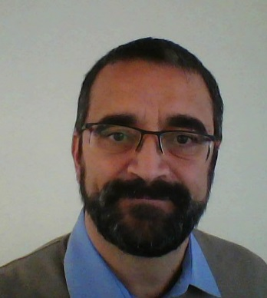
DIA CSP AHM 22-Dec-2016
Program Coordinator - Pierre-Yves De Zeeuw (DE, Germany)
Physician (GP) by training, Pierre was involved in clinical trials since 1989. He joined the industry in 2001 and started in Clinical safety and pharmacovigilance in 2004, which was the date of my first membership to DIA. Pierre has worked for all types of structures, including CROs, medium sized pharma companies and academic organizations. He is currently therapeutic area lead for clinical safety and pharmacovigilance of cardio-renal products at Otsuka and also managing a team of safety scientists supporting physicians for risk evaluation and reporting activities.

Slide 10
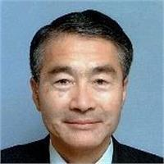
DIA CSP AHM 22-Dec-2016
Member Engagement Coordinator - Teiki Iwaoka (JP)
Dr. Iwaoka has his Ph.D. and MS in Chemistry. Currently is is an Executive Consultant and Director of CAC Exicare. Teiki has worked previously with Sankyo Co. Ltd as Deputy Director in Drug Safety Information and Development.

Slide 11
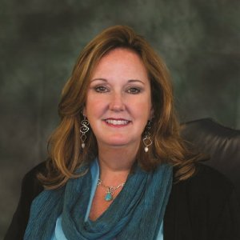
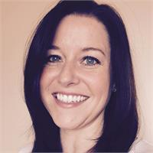
DIA CSP AHM 22-Dec-2016
Meet your new Leadership Team!

Slide 12
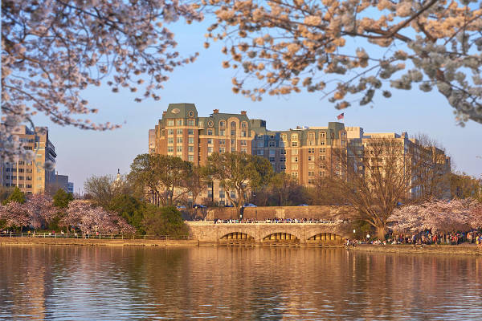
DIA CSP AHM 22-Dec-2016
January 2017 Safety/PV Conference in DC Update
January 21 - 25, 2017
Mandarin Oriental Washington D.C.

Slide 13
DIA CSP AHM 22-Dec-2016
2017 PV & Risk Management Strategies Conference
Who’s coming???
Message from Co-Chair Beth Garrard

Slide 14
DIA CSP AHM 22-Dec-2016
Did you know…we’re still #2!!!
The Clinical Safety & PV Community has THE 2nd HIGHEST community members of DIA!
Regulatory Affairs has 595
Clinical Safety & PV has 386
Clinical Research Community has 378
Good Clinical Practices & Quality Assurance Community has 335

Slide 15
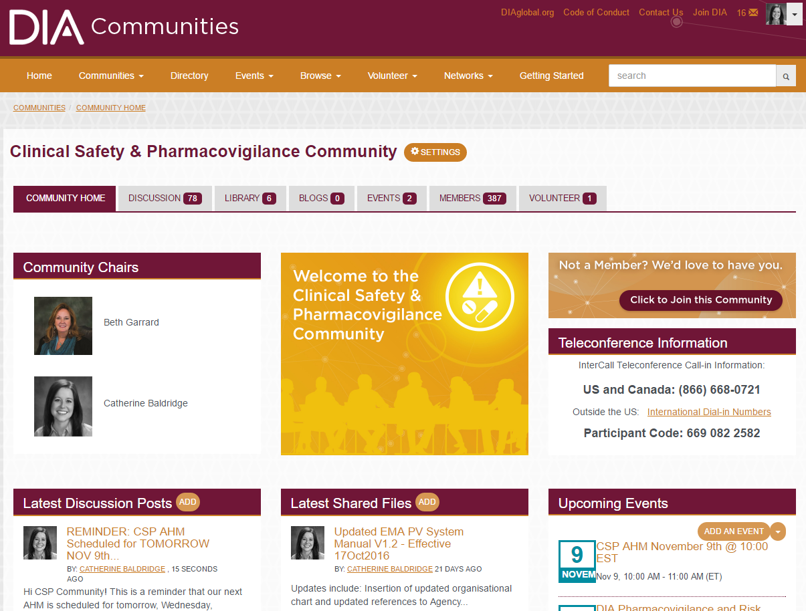
DIA CSP AHM 22-Dec-2016
Our Community Page & Activity
Remember to
Go Look!

Slide 16
DIA CSP AHM 22-Dec-2016
Open Forum

