Slide 1
Patient Engagement Community
Monthly all-hands meeting

Slide 2
Data Privacy and Data Sharing in Clinical Trials DIA Patient Engagement Community Meeting 09 March 2023 Devaki Thavarajah PHUSE Data Transparency Working Group Lead

Slide 3
PHUSE
PHUSE is a free-to-join global Community of data scientists. We are a platform that promises connection and knowledge sharing, committed to providing open access to knowledge resources for industry professionals.
Our mission is to share ideas, tools and standards around data, statistical and reporting technologies to advance the future of life sciences.
Find out more at www.phuse.global
Notes:
PHUSE is a non-profit organisation providing the healthcare industry with the premier platform for creating and sharing ideas, tools, and standards around data, statistical and reporting technologies; PHUSE is a community of data science professionals who are passionate about advancement of clinical information and the future of life sciences.

Slide 4
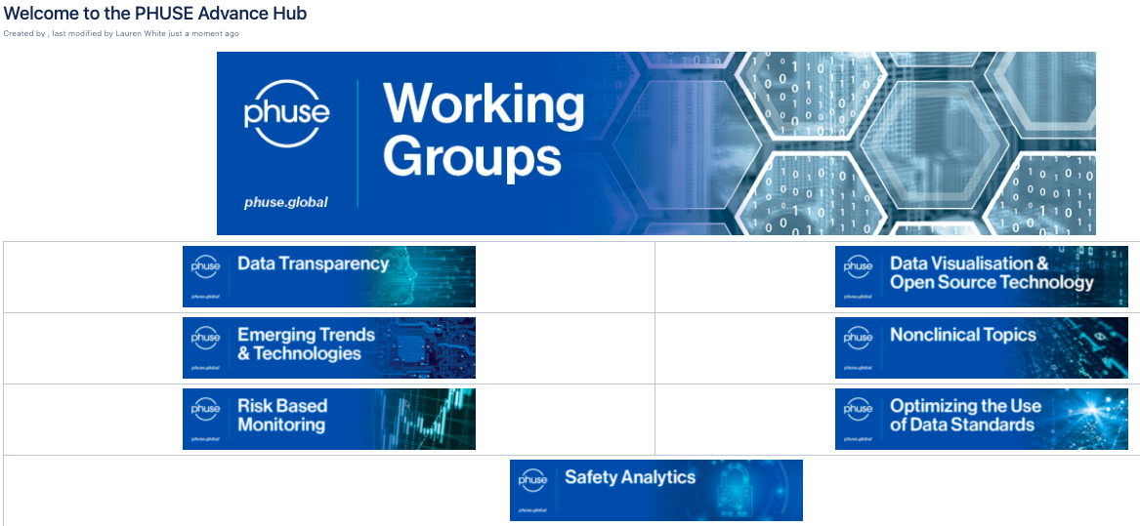
PHUSE Working Groups
PHUSE collaborations are organised into a number of specialist Working Groups, each with a broad topic area. The Working Groups have specific projects designed to achieve a set of particular objectives.
Working Groups include volunteers from:
major stakeholders including academia
the pharmaceutical industry
biologics industry
device industry
contract research organisations
core laboratory organisations
technology vendors
SDOs
interested regulatory agencies
Participation is open to anyone who would like to contribute, visit the Advance Hub for more information.

Slide 5
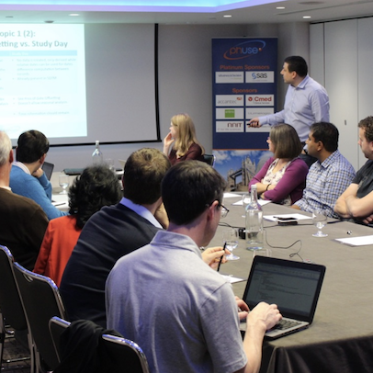
PHUSE Data Transparency Working Group has been active since 2014
2
Virtual meetings per Year
19+ Deliverables Published
Current Projects
Educating General Population | EU CTR
Good Transparency Practices | Rare Disease/Small Population Data Sharing
Stakeholder’s Deliverables Review | Internal Clinical Study Data Sharing Process
70+
Members
Virtual Collaboration throughout the Year
CSS
Break-out Sessions with Regulators
New project:
Anonymization of Imaging Data. Call for volunteers will be open soon, if interested please email workinggroups@phuse.global

Slide 6
PHUSE, Data Transparency & Interaction with Regulators
FDA joins the PHUSE Data Transparency Working Group
&
PHUSE Data Transparency Working Group comments on FDA Clinical Study Pilot
FDA refers in a press release to the PHUSE Data Transparency WG for their efforts in developing anonymization standards and best practices
PHUSE Data Transparency Working Group invited to comment on EMA Policy 0070 Phase 1
EMA references PHUSE Data De-Identification Standard in Policy 0070 External Guidance as a tool to identify quasi and direct identifiers
Health Canada selects representation from the PHUSE Working Group in HCRG PRCI
PHUSE Data Transparency Working Group comments on Health Canada PRCI Guidance
EMA and Health Canada participate in the Good Transparency Practices project
PHUSE commented on EMA Policy 0070 initial draft for public review
2013 | 2014 | 2015 | 2016 | 2017 | 2018 | 2019 | 2020 | 2021 | 2022
PHUSE Data Transparency Working Group is founded!
PHUSE Data
De-Identification Standard is released
EMA participates in EU CSS in London
FDA participates in CSS in Silver Spring
EMA particiaptes in EU Connect in Amsterdam
EMA, FDA and
Health Canada participate in
Virtual CSS
EMA participates in EU CSS in Basel
EMA participates in
Virtual CSS
FDA and
Health Canada participate in CSS
in Silver Spring

Slide 7
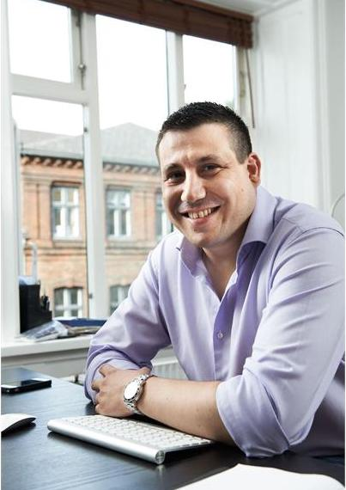
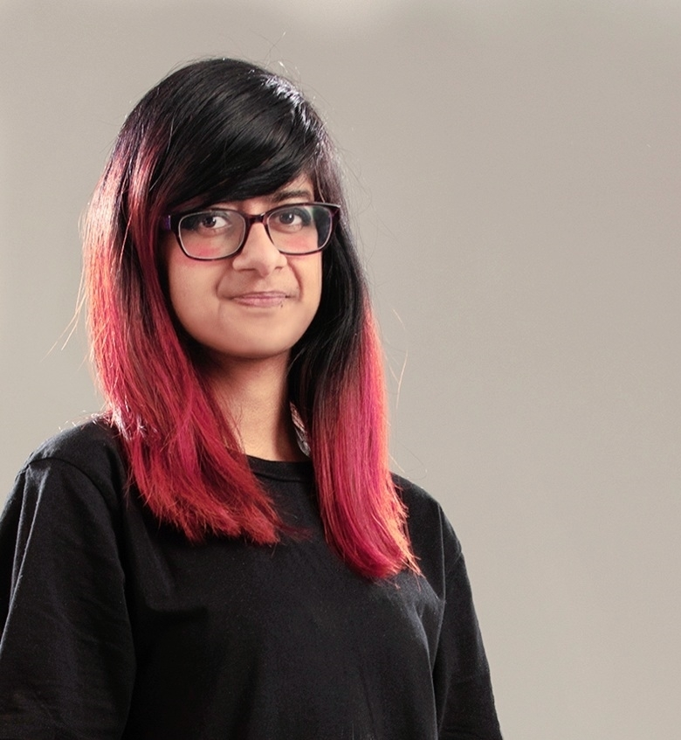
DT Working Group Leadership Team
Stephen Bamford | Jean-Marc Ferran | Devaki Thavarajah | Muhammad Oneeb Rehman Mian
Stephen is the Head of Clinical Data Standards & Transparency at the Janssen Pharmaceutical Companies of Johnson & Johnson. He has over 25 years of experience in the management of clinical trial and research data with pharmaceutical, life science and research organizations. In 2004, Stephen founded the PHUSE organization. | Jean-Marc is an Independent Consultant with more than 15 years of experience in the Life Sciences industry. Prior to starting his company, Qualiance, he worked as a Statistician and Director of Statistical Programming at Novo Nordisk and Ferring. Jean-Marc has led the PHUSE Data Transparency Working Group since 2014. | Devaki partners with pharmaceutical clients, members of the research and healthcare community globally to help meet their clinical trial transparency and disclosure requirements. She has 8 years’ experience within the pharmaceutical and healthcare industry. | Muhammad Oneeb Rehman Mian is a Senior Manager of Privacy & Data Enablement for the Clinical Trials Transparency (CTT) business stream at Privacy Analytics. He provides technical leadership and subject-matter expertise for privacy methodology and solutions.

Slide 8
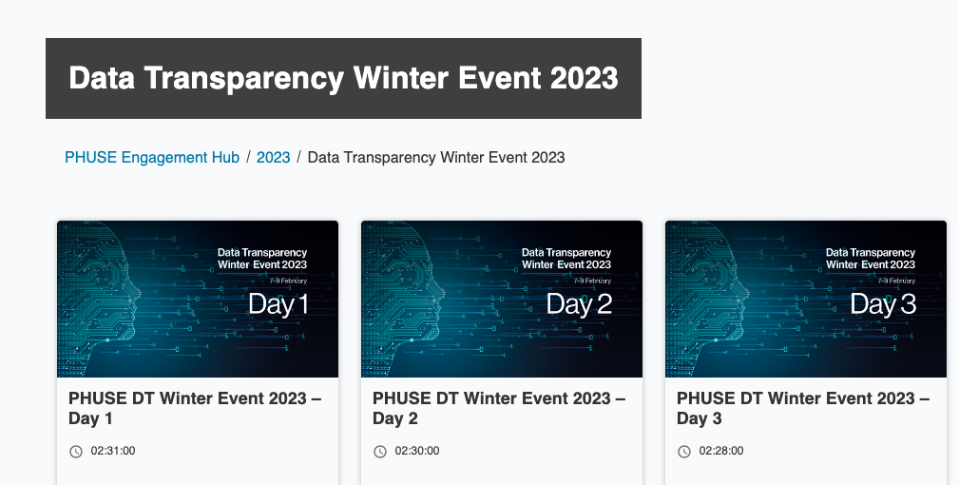
Watch On-demand
Notes:
Here, we share essential knowledge of the field and create an open space where questions can be asked, and challenges addressed.

Slide 9
What’s Next?
Data Transparency Working Group
There are currently seven active projects within this Working Group that you can get involved in. Contact workinggroups@phuse.global to express your interest
DT Summer Event
The DT Working Group will be hosting another Data Transparency Event 20-22 June!
CSS 2023 – Silver Spring, MD
Attend the CSS in September for daily break out sessionsfrom the Data Transparency Working Group.
Event Summary Blog
Read the full blog summary with the extensive details of what the Data Transparency Event entailed
Notes:
Link Winter Event 2023 blog when posted
Show demo of Advance Hub at the end of meeting

Slide 10
Educate the General Population on Data Privacy and Data Sharing Working Group Team
Project Members
Audio and Visual Team
Barbara E. Bierer
Benjamin Shim
Bhargavi Raghavan
Dan Bilodeau
Deborah Collyar
Diane Heditsian
George Allan
Jean-Marc Ferran
Laila Albanna
M Davis
Nathalie Jullian
Nastazja Laskowski
Nicole Hinton
Rene Allard
Sanjay Bagani
Shannon Lefaivre
Sharon Niedecken
Sherry Meeh
Sophia Zilber
Subhayan Das
Sudipta Chakraborty
Susanna Mammen
Sylvia Baedorf Kassis
Taniya Rade
Viveka Rydell-Anderson
Vivien Fagan
Dmytro Korolkov (Videographer)
Kayley Stephens (PHUSE Comms & Marketing)
Project Leads
Devaki Thavarajah
Paula Rowley (PHUSE Project Coordinator)
Notes:
First of all, a big thank you to everyone in our project team :) Our project team comprises of several different stakeholder representatives from across the globe with subject matter expertise in their field; their backgrounds include pharma, academia, patient advocacy groups and creative publishing industries.

Slide 11
Agenda
Demystifying clinical trial information and results reporting, common misconceptions and tackling misinformation
Deliverables Development
Video Dissemination Information Gathering Exercise
Notes:
Considering the vast ways data can be used, it is understandable some folks may be alarmed but it is important to reassure there are extensive safety measures to protect data :D

Slide 12
Demystifying clinical trial information and results reporting, common misconceptions and tackling misinformation

Slide 13
Examples of common misconceptions
“COVID-19 vaccine includes a tracking device, the vaccine is unsafe because it was developed so quickly, and it causes infertility in women”
“Being in a clinical trial won’t help me”
“If you sign up for a clinical trial, you lose control of your personal health information”
“Clinical trials are dangerous because they use new practices and medicines”
Notes:
The pandemic in particular has increased public interest in clinical trials. Here are some examples of common misconceptions.
Summary of common misconceptions from: https://www.muhealth.org/our-stories/covid-19-vaccine-myths-vs-facts
https://www.rochecanada.com/en/media/in-focus/5-common-myths-about-clinical-trials.html
https://catalyst.phrma.org/debunking-common-myths-about-clinical-trials

Slide 14
Project Scope and Delivery
There is increasing interest by the general public in data privacy and sharing and most publicly available information is targeted towards individuals with training / experience / expertise in these areas
Accessible and understandable content will increase general public knowledge (and accuracy)
This project focuses on creating engaging content on data privacy and data sharing that can be understood and used by the general population (any member of the public regardless of their sector or profession)
Ultimately, this understanding will enable viewers to become more informed, thus helping to have a positive impact on their families and the wider community.
Notes:
The project is to follow a similar approach to the PHUSE Data Transparency (DT) Terminology Harmonisation project, this time aiming towards a more general audience to address commonly asked questions surrounding data privacy and data sharing. This includes covering topics such as what is being done to share clinical trial data and information, where data goes and how it is used, what data privacy is, why it is needed, why it is important and the differences between mandatory vs. voluntary data sharing.

Slide 15
Deliverables Development
Notes:
https://drive.google.com/drive/folders/1D04OfGJeI1Lw9iJUB6B-zZpZQ9-8LIcw

Slide 16
Video Topics
Video 0: Introductory video (teaser)
Video 1: Importance of Clinical Trials
Video 2: What will I receive and when will I receive it?
Video 3: What is Clinical Data?
Video 4: Journey of a data point
Video 5: What is data sharing, why do we share data and what are the differences between mandatory vs. voluntary data sharing?
Video 6: What is data privacy?
Notes:
We are currently working on writing a script for short videos around 3-5 minutes each to cover different aspects of data privacy and data sharing, incorporating examples where appropriate to help the audience see how it relates to daily situations and develop infographics and/or narrative depending on the content in parallel with the video to provide context, and a link to credible sources for background reading for those who wish to read more about the topics. The goal is to help debunk myths/tackle misinformation throughout the series of videos. The first video will be an introduction/high-level overview of clinical transparency and will act as a teaser/trailer as to what the audience can expect in the video series.
The first two videos will enable us to explore what works well when combining our script content with audio and animations to achieve maximum impact in conveying information.
We are liaising with a third party vendor to create the videos for finalised scripts. The videos will be uploaded to YouTube and additional PHUSE online communication channels will be utilised such as LinkedIn and Twitter to share video links. The creation of videos will provide the opportunity to create a wider outreach online and help distribute fair and accurate information to a range of audiences. There will also be an interactive element whereby the audience are asked for feedback or to suggest what topics they would like us to address in future.

Slide 17
Character 1
Character 2
Notes:
Conversation will take place between two characters. We will have two people, for example, Patty Participant is interested in joining a clinical trial, she expresses her concerns for data privacy and how data will be used etc. The other person (Tammy Trial, is a friend who works in clinical research) answers Patty’s questions. This question-answer style interaction will be engaging for the audience and we shall first cover basic concepts, then build on the different layers as a continuity piece.
The characters build the discussion in each video. All videos will be standalone (one video is not dependant on another) and when watched together, the viewer can see the big picture on data sharing and transparency as a whole.
In this current day of the digital era, patient groups believe videos are the preferred method of learning in a clear and understandable way. It's a mixture of visual and auditory learning. Hard of hearing will also be addressed in that video subtitles will be included.
Understanding the patient voice is important and will help them to feel comfortable. Tammy Trial assesses the questions from her friend, who represents many folks out there who aren't within the field of clinical research. We will help the audience to understand the foundation concepts of clinical trials, before delving into the topics surrounding data. We also want to demonstrate that they are respected as individuals and will see that research is for public good and loved ones will continue to benefit from healthcare. Generally, bridging the gap and greater knowledge will empower the listener and resulting in a more informed society.

Slide 18
Video production and process
1) Starting a contract;
2) Send approved (final) script;
3*) Voiceover artist selection;
3.1*) Voiceover creation;
3.2*) Approvement / some fixes to record if needed;
4) Storyboard creation (sketched / drawn scenario based on the script);
4.1) Approvement / discussion
5) Animation creation;
6) Discussing edits if required and implementing changes
*can go in parallel with storyboard creation
Notes:
So we have determined that videos will be the key focus as this maximises effectiveness of conveying information today, especially in the current digital age where there will be a wider outreach.
Now we will take a brief look at the video production and process. The vendor (Dmytro Korolkov) is a talented animator working on a range of deliverables and his portfolio is available online. He has previously developed videos for Janssen and is excited to be working with us on this project.
It will take us approximately 1 month to produce each video.

Slide 19
Video 0 – Introductory teaser
Here, we are first introduced to the two characters in our video series.
Ms Patty Participant is interested in joining a clinical trial, voices their concerns for data privacy and how their data will be used, etc.
The other person, Ms Tammy Trial (a friend who works in clinical research), answers their friend’s questions.
Notes:
The finalised approved content for our first two pilot videos can be accessed via the following link.

Slide 21
Video 1 – Importance of Clinical Trials
The first video in the series covers the key concepts of clinical trials before delving into more complex topics.
Our two characters will build upon the discussion in each video, and on the different layers as a continuity piece.
Each video layer in the series can be standalone (one video is not dependent on another) and when watched together, the viewer can see the big picture of data privacy and data sharing in clinical trials.
Notes:
The finalised approved content for our first two pilot videos can be accessed via the following link.

Slide 23
Video Dissemination Information Gathering Exercise

Slide 24
Group Discussion
Which best describes your background?
Patient Advocacy Group
Pharmaceutical Industry
Academia
Patient
Carer
Other
Notes:
Quick show of hands
Interactive session
Data privacy is essential in healthcare and extends into other areas as technology is constantly advancing. Ultimately, by watching these animated videos and gaining an understanding of data privacy and data sharing in clinical trials, this allows the viewer to become more informed, thus helping to have a positive impact on their families and the wider community in becoming more aware, not only gaining perspective into debunking myths about clinical trials but may also inspire them to become more open to not being swayed by misinformation in other areas as well because the intention of advancing technology is not to create mistrust in the user, but help to improve the quality of life whilst maintaining the highest data privacy standards.

Slide 25
Group Discussion
Would you be keen to promote these videos in your network?

Slide 26
Group Discussion
If you were a clinical trial participant, what additional key questions would you want to know about clinical trials?

Slide 27
Group Discussion
Are you interested in reviewing or giving input to the next videos?
Please see below our recommended video order. Future scripts in this series, currently under development are denoted as ‘Link TBC’
Video 0: Introduction
Video 1: Importance of Clinical Trials
Video 2: What will I receive and when will I receive it? – Link TBC
Video 3: What is Clinical Data? – Link TBC
Video 4: Journey of a data point – Link TBC
Video 5: What is data sharing, why do we share data and what are the differences between mandatory vs. voluntary data sharing? – Link TBC
Video 6: What is data privacy? – Link TBC

Slide 28
Group Discussion
How would you like to see these videos being shared and distributed with patients, their carers and doctors?

Slide 29
Group Discussion
Who else should the videos be disseminated to?

Slide 30
Thank you!
Any additional points you would like us to take note of? ☺
If you are interested in participating in this project, please email: workinggroups@phuse.global

